Slide 1
Q1) Do movies become profitable with longer runtime?

Slide 2
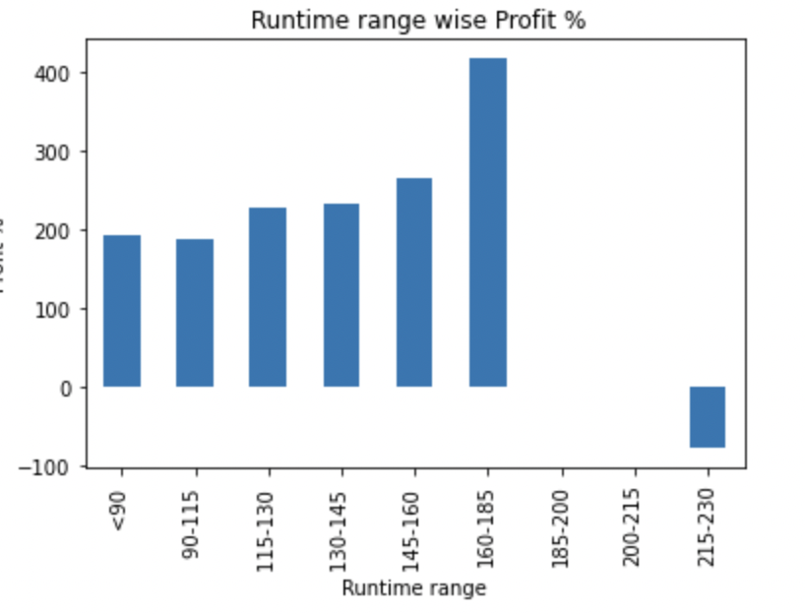
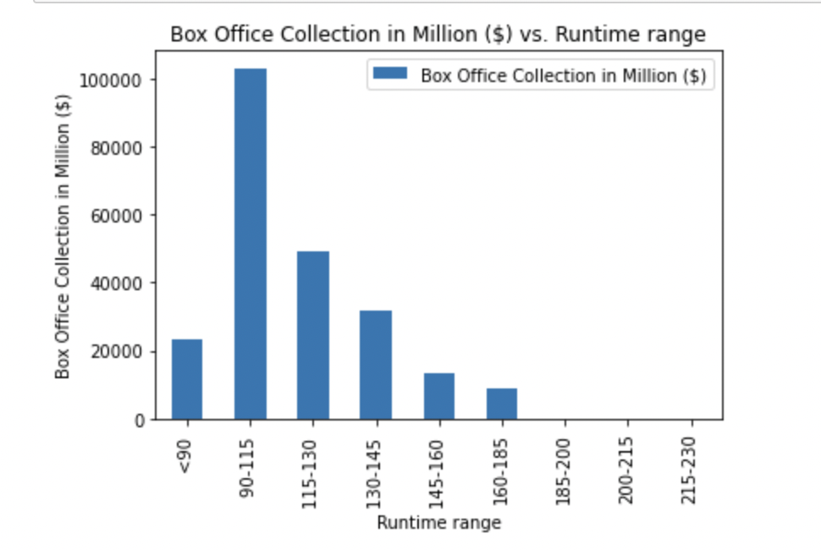
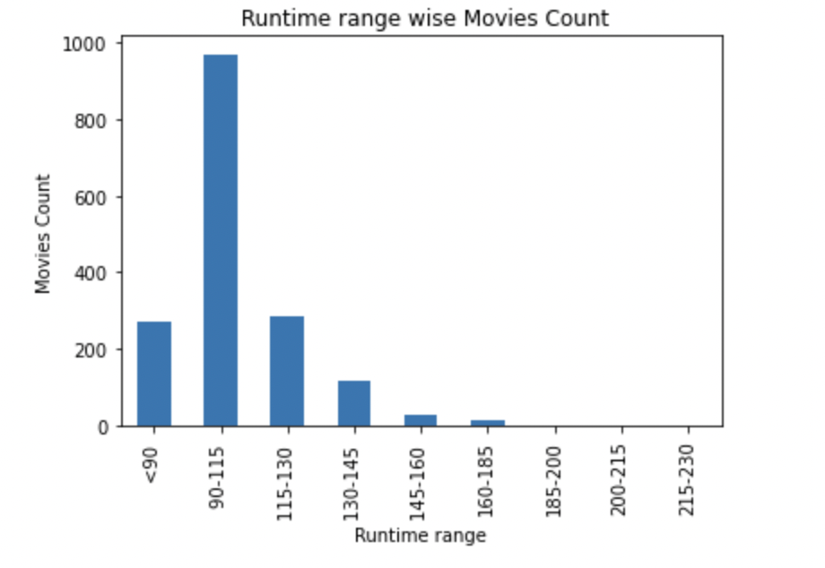
Analyzing movie runtime effect on profit%, Box office collections and number of releases. Here we can see that 90-115 range has the highest box office collection and maximum no. of releases while 160-185 made the highest profit% so we don’t find any direct relation here.

Slide 3
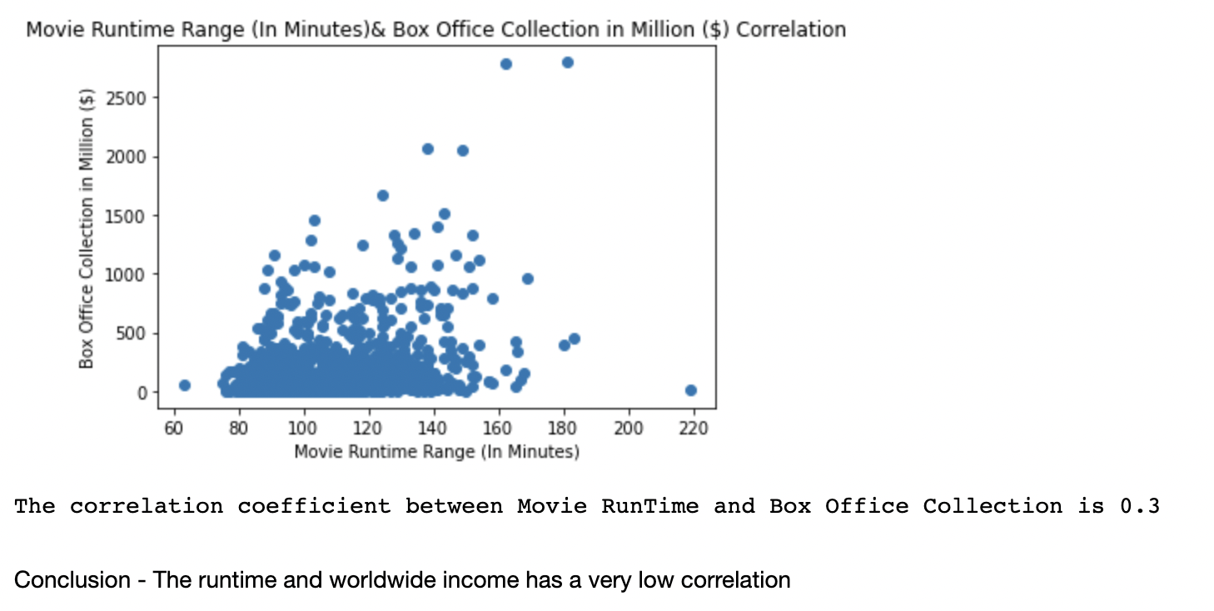
Correlation Analysis between Movie runtime range and Box Office collections

Slide 4

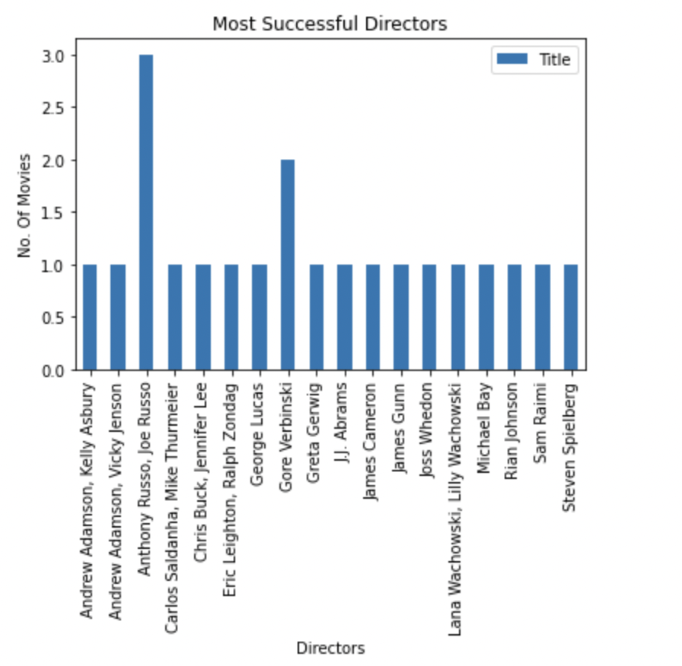
It clearly shows in actors, Robert Downey jr is the most successful who has done 3 while Ewan Mcgregor, Johny Depp and Mark Hamill has 2 biggest blockbuster movies while Anthony Russo, Joe Russo are on the top with 3 and Gore Verbinski is the second most successful director with 2 biggest blockbuster. Note- Biggest blockbuster is the movie which has the highest box office collection and profit.

Slide 5
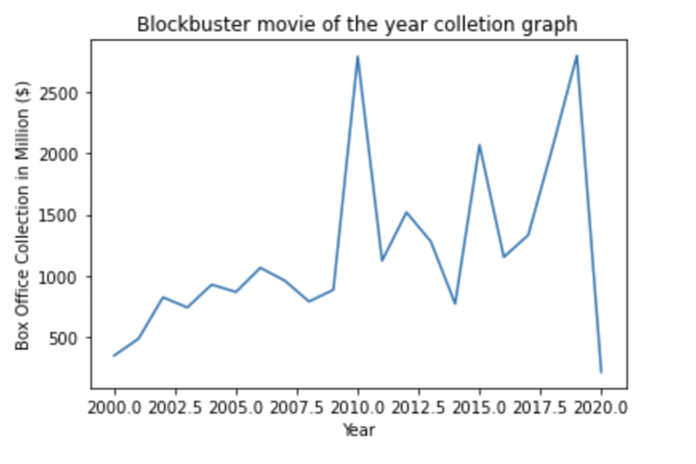
The income of the biggest blockbuster of the year is increasing increasing every year with an exceptional drop in 2020 due to global pandemic.

Slide 6
Does the movie release time affect the profitability the movie?

Slide 7
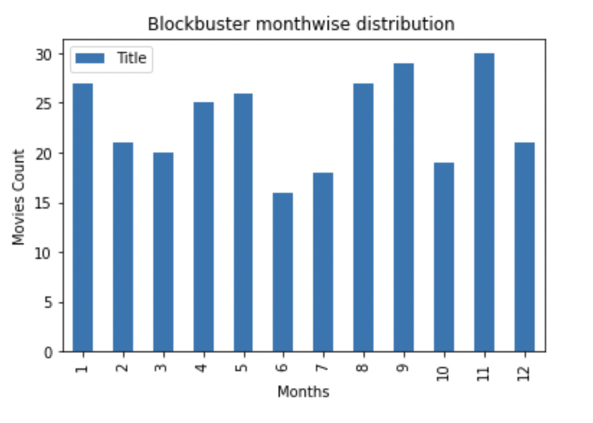
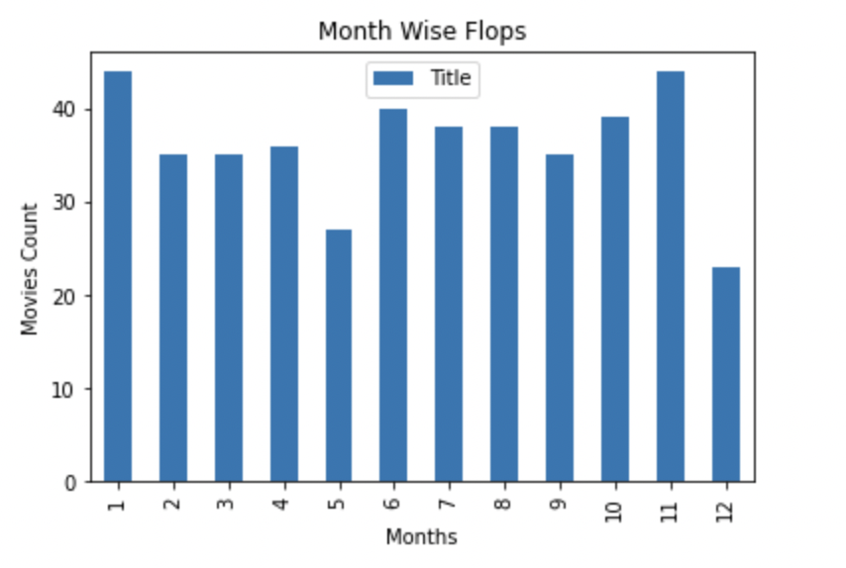
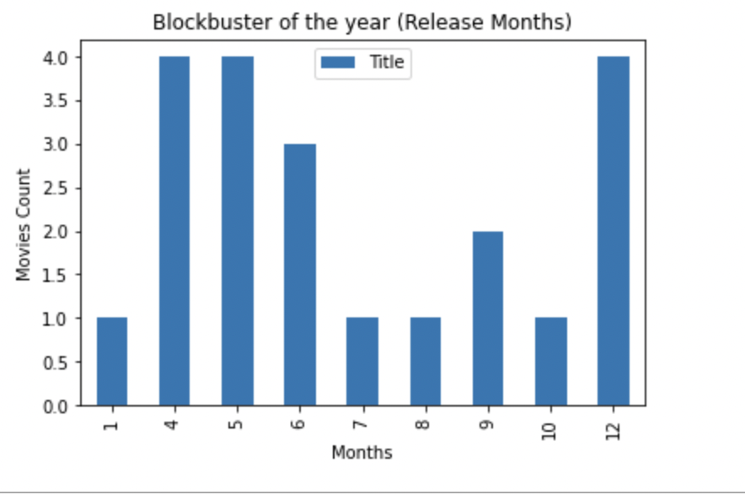
Analyzing release time and profitability here. Looking at graphs we can say that May, December months are best for the release of movies as it has given four biggest blockbusters more than twenty blockbusters and the lowest flops while July and October are not the best time to release movies since they produced high no. of flops and low no. of blockbusters.

